Slide 1
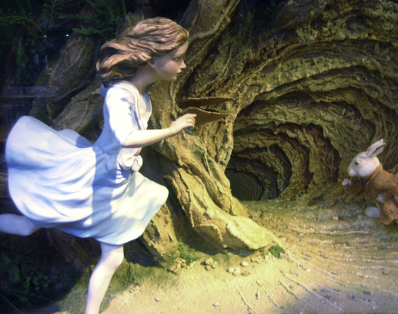
The pipe! … and stuff
Learning to “talk” R

Slide 2

Review
What’s the difference between RStudio and R?
What are the functions of summary(), glimpse(), head()?

Slide 3

What am I doing?
Push rubber lever
Push stick
Unpush rubber lever and push another rubber lever
Unpush that rubber lever and push the first rubber lever again
Pull stick
Unpush rubber lever and push another rubber lever
Unpush that rubber lever and push the first rubber lever again
Push stick again but differently
…

Slide 4
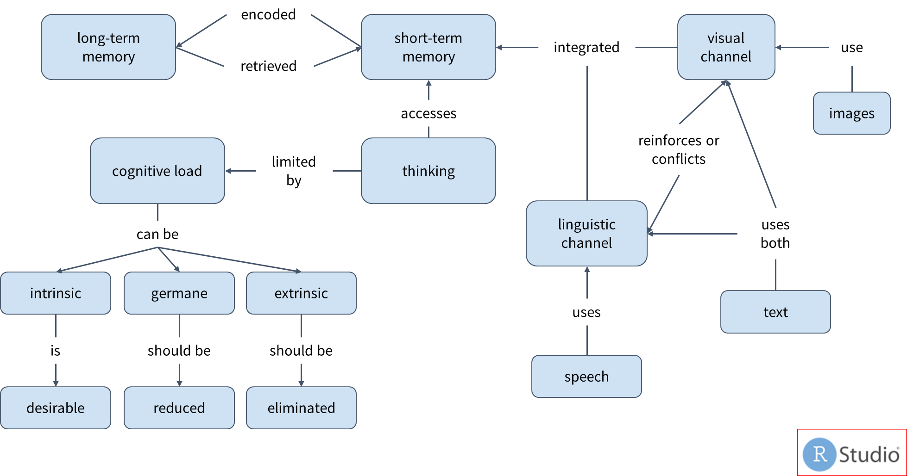
Cognitive Load
Notes:
Concept map for cognitive load.

Slide 5
Cognitive Load, simple version
Do one thing at a time!

Slide 6
Base R is hard
as.character(Staffs$`Staff Name`[match(Result$`Regional ME Staff`,Staffs$ID)])

Slide 7
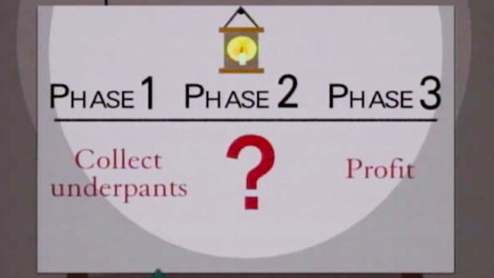
The secret to de-hardifying stuff!
Plan
Do

Slide 8
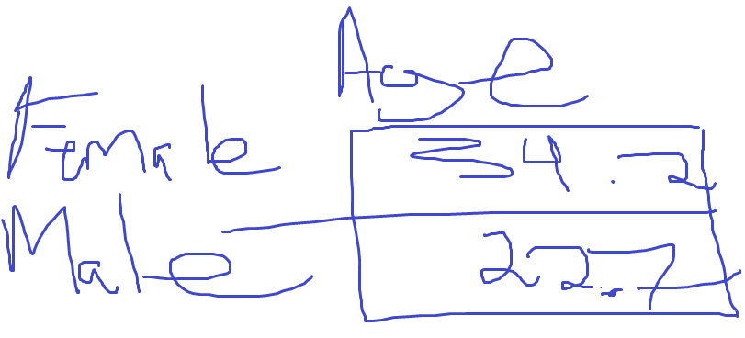
Think through a problem first
Take a dataset and then
Filter it down to only rows where Village is “Washington DC” and then
Create groups by Gender
Do a summary of the mean Age
I expect something like this:
Take a dataset and then
Filter it down to only rows where Village is “Washington DC” and then
Create groups by Gender
Do a summary of the mean Age
I expect something like this:

Slide 9
The Tidyverse way
1. Plan
Take a dataset and then
Filter it down to only rows where Village is “Washington DC” and then
Create groups by Gender
Do a summary of the mean Age
2. Do
df %>%
filter(Village == “Washington DC”) %>%
group_by(Gender) %>%
summarize(MeanAge = mean(Age))
Exception ggplot2 uses “+” instead of “%>%”

Slide 10
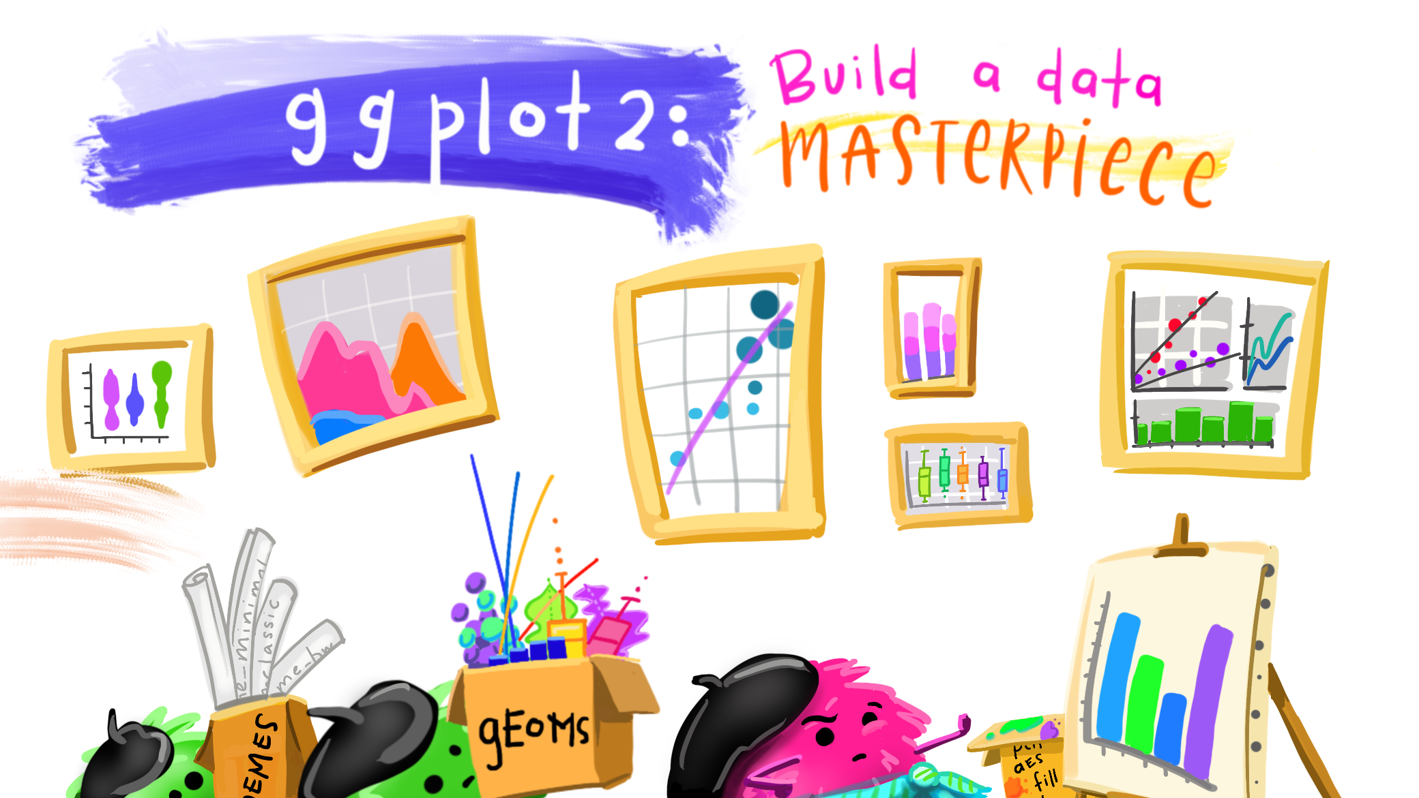

Slide 11
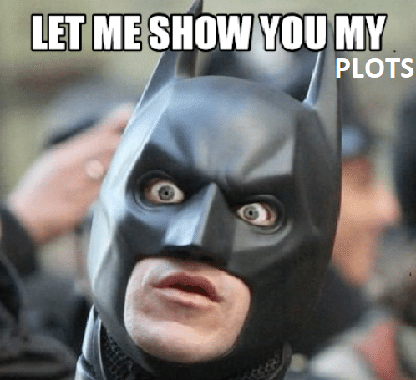
Ggplot grammar
ggplot(data, whatGoesWhere) + showHow
x, y, color, shape… points, lines, histograms…

Slide 12
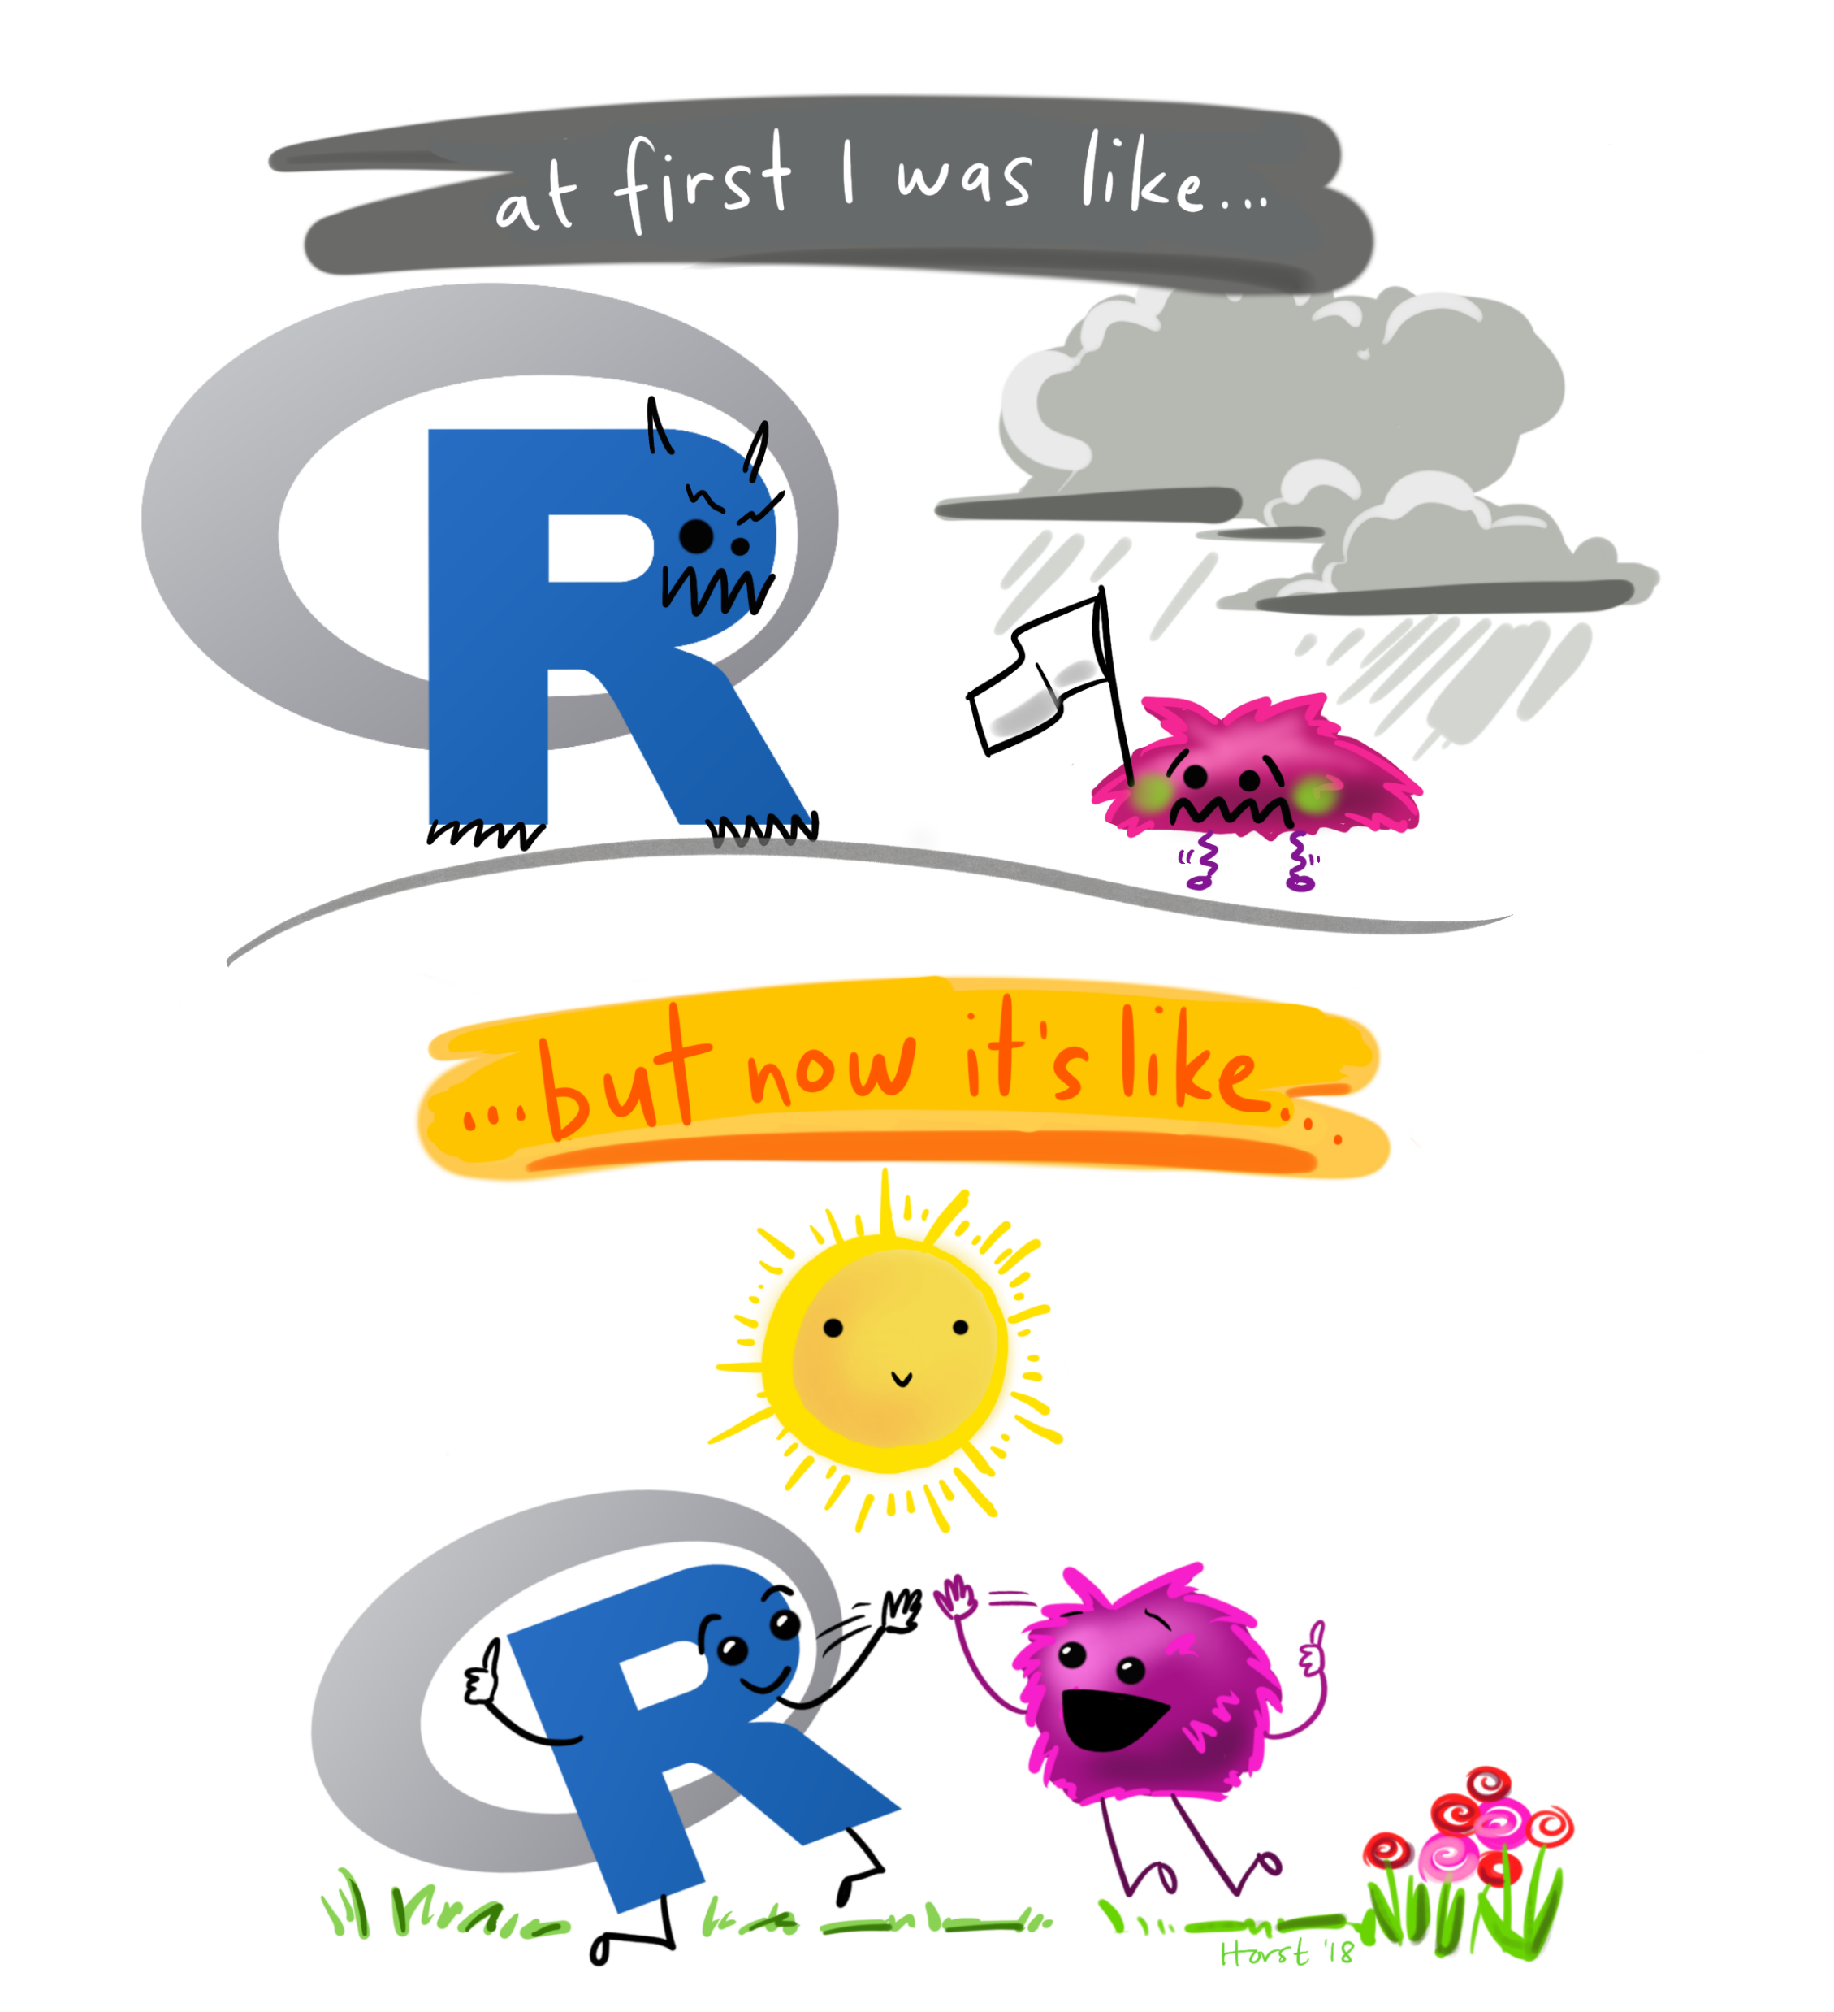
What we learned
Theory:
How to subset a data.frame
%>%
A bit of ggplot2
Practice:
Light plotting with ggplot2

